Slide 1
Fatal Force Police Shooting in US
Machine Learning Approach
Fanyu Zuo
Pinky Sindhu

Slide 2
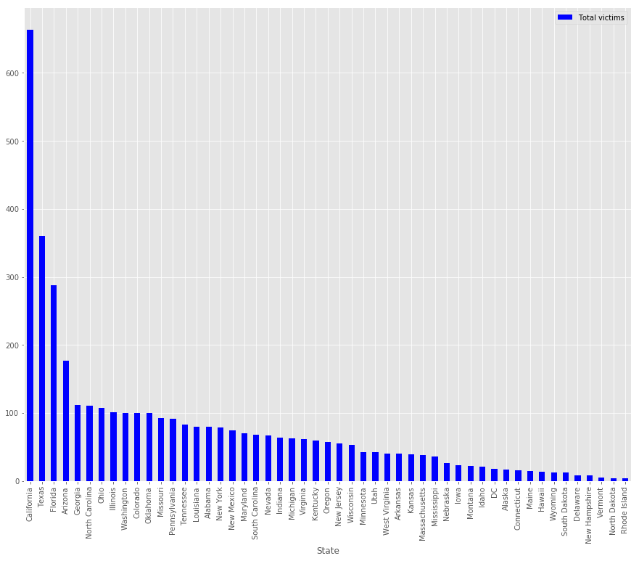
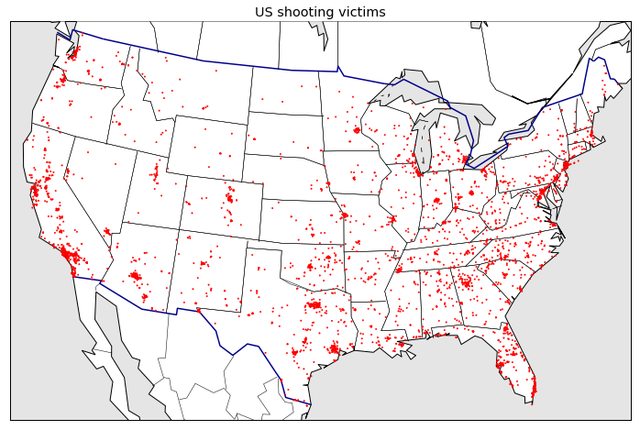
Dataset Exploration
The shooting data is from the Washington Post and the Mapping Police Violence database. The covariate data comes from various US Census and the FBI Uniform Crime Reporting database.
3,918 tuples, 47 attributes.
Data from 2013 - 2016
Across US
Target Attribute: Mental illness

Slide 3
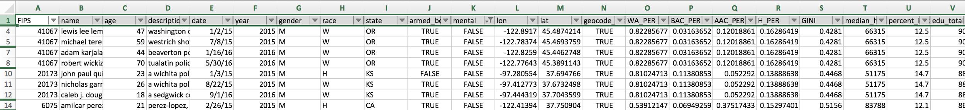
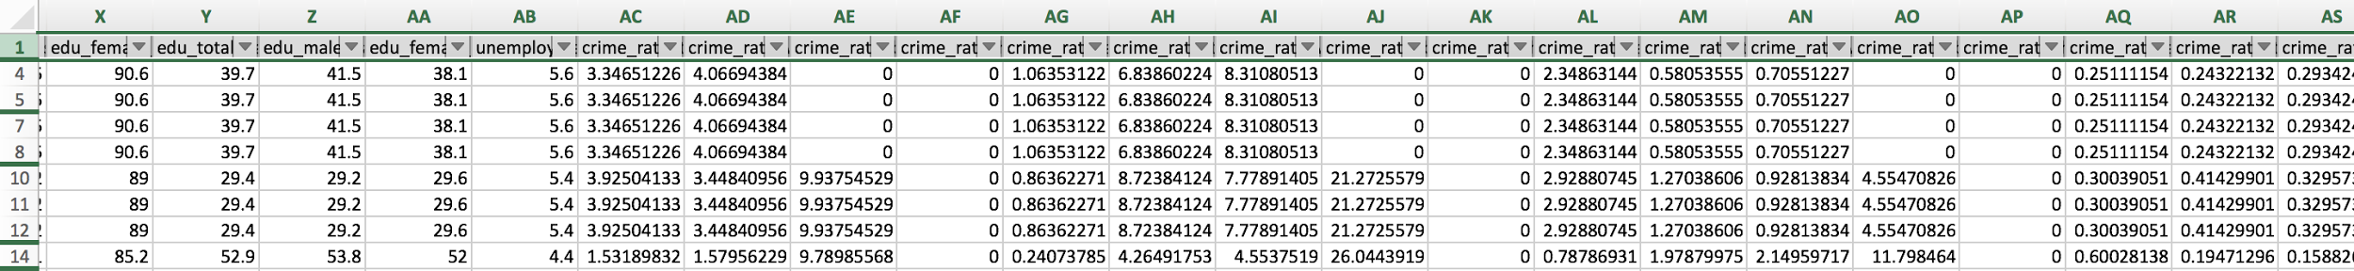
DataSet Snapshot
47 attributes:including name, age, race, mental health, education, armed and the incidents description (text) from police

Slide 4
Methods Description
Text Classification with Naive Bayes
Text Classification with Logistic Regression
Multiple Classifiers on Numerical Attributes
SVM
Random Forest
Decision tree
Train dev test split: 70% : 15% : 15%
Tuned the hyperparameters for model accuracy
Selected the model based on Accuracy and F1 Score
Evaluated the results via Text Mining

Slide 5
Text Classification
Naive Bayes using the Bag of Words Model
Data preprocessing (generate and split two txt files based on the mental illness, strip all strings)
Tuning Hyperparameters
Stop Word (Nltk lib)
Lower Frequency (<2)
Model Accuracy : 88.62% (with filters)
F1 Score : 0.9397
Model Accuracy : 86.90% (without filters)
F1 Score : 0.9299

Slide 6
Text Classification
Logistic Regression using the TfidfVectorizer implementation
Transforms text to feature vectors that can be used as input to estimator.
Tuning
Cleaned the data and Removed the Stop Words
L1, L2 , cost values
GridSearchCV
Performance
Accuracy | 88.40%
Accuracy (After Tuning) | 89.70%
Precision | 0.87
Recall | 0.81
F1 Score | 0.8387

Slide 7
Classification with numerical attributes
Remaining attributes: Age, Gender, Education, Race, Crime Rate
Stratified Sampling
Models Created
Random Forest
Decision Tree
SVM
Performance
Model | Accuracy | F1 Score
Random Forest | 69.6% | 0.54
Decision Tree | 65.2% | 0.50
SVM | 67.4% | 0.52

Slide 8
Comparison of Models
Model | Accuracy | F1 Score
Random Forest | 69.6% | 0.54
Decision Tree | 65.2% | 0.50
SVM | 67.4% | 0.52
Naive Bayes | 88.62% | 0.94
Logistic Regression | 89.70% | 0.84

Slide 9
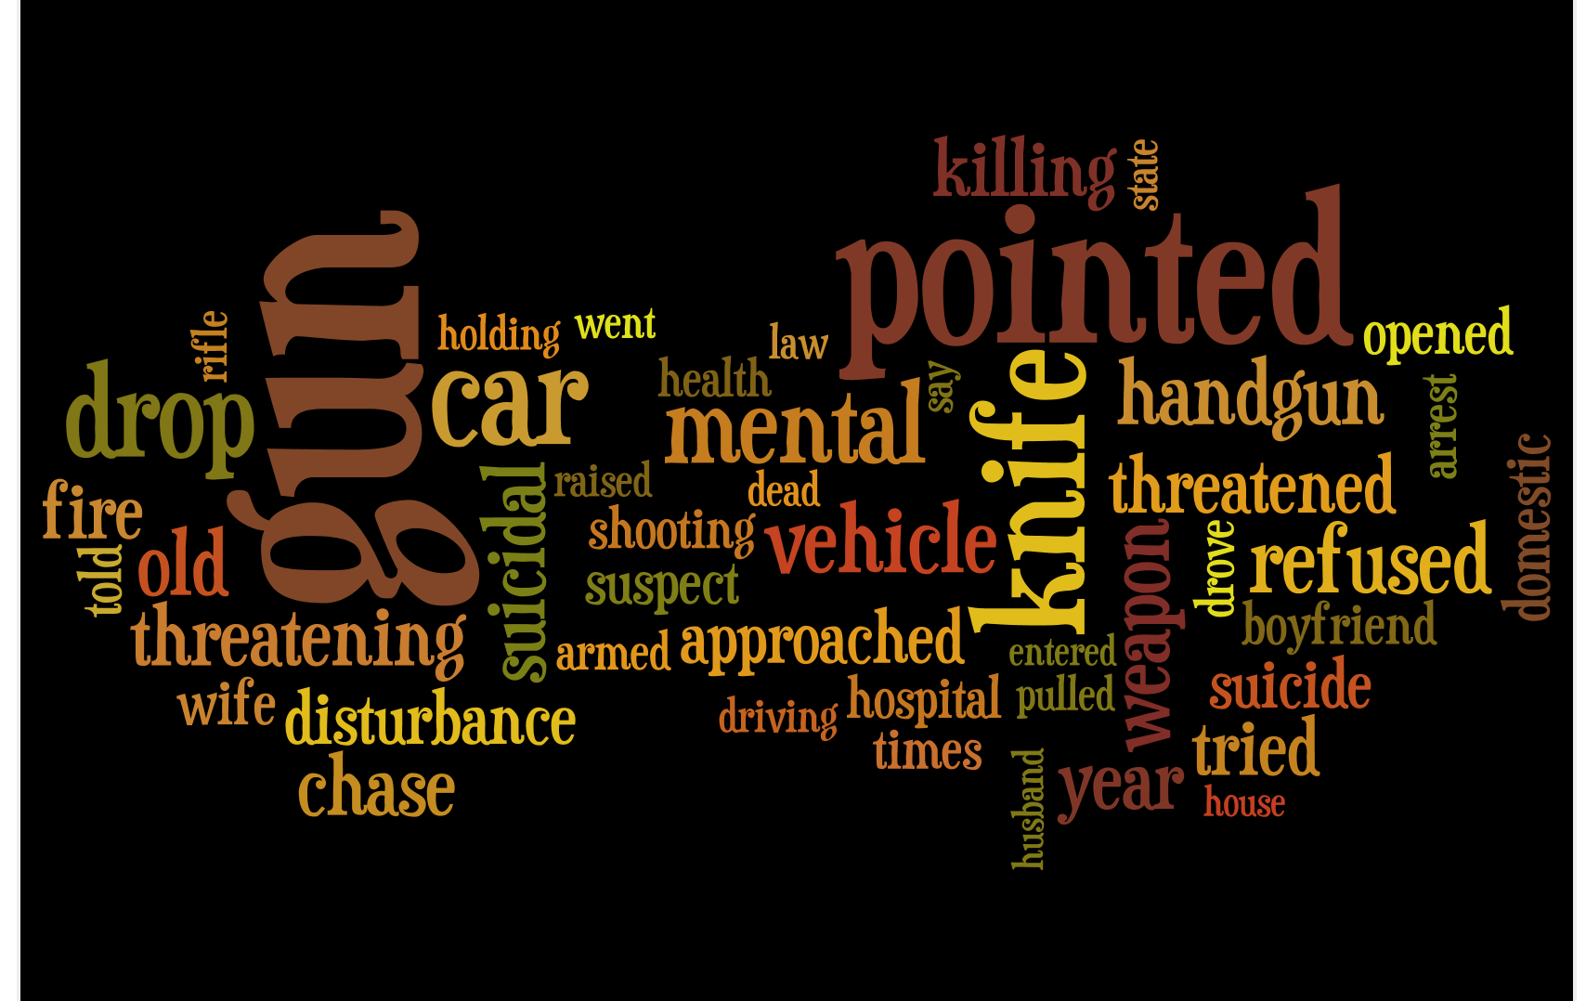
Evaluation With Text Mining
Process Docs
WordList->Data
Tokenize
Filter Stop Words
Frequency
Wordle Cloud

Slide 10
Conclusion
Text Based Classification yields higher accuracy.
F1 Score is chosen to evaluate the model due to the imbalance nature in data.
Naive Bayes and Logistic Regression is selected as appropriate classifier for this dataset.

Slide 11
QUESTIONS ?

